Slide 1
1st PROJECT PRESENTATION GROUP 2
ANALYZING THE TYPES AND AMOUNTS OF FEDERAL LOANS GIVEN TO STUDENTS IN AMERICAN COLLEGES
ACADEMIC YEAR: 2020 - 2021
Tianxiao Cao
Peter Gruskin
Mu Li
Michael Roberts
Columbia University School of Engineering
Data Analytics Boot Camp Program
August 17, 2023

Slide 2
Nature of our project
Our primary area of interest is the amounts of money given in federal loans to students attending US colleges, universities, and training institutions.
We examined a dataset with student loan data for the academic year 2020-2021.
In our initial analysis, we identified:
Five categories of federal loans through which loans were disbursed.
Three types of US schools where students received loans.
Our main goal is to see how these loans are disbursed by state, school types and loan types.

Slide 3
Implications of our Findings and Discussion
States with large urban areas as Texas, California, New York, and Penn have received the most loans, have the most loan recipients and have the most public and private schools
The southern region received the most loans and have the most loan recipients.
The two Federal loan categories with the highest loan disbursements (unsubsidized graduate and unsubsidized undergraduate) have interest rates which have implications for students ability to repay their loans.

Slide 4
Section 1
Overall Information by State
(CA, TX, NY, PA…)

Slide 5
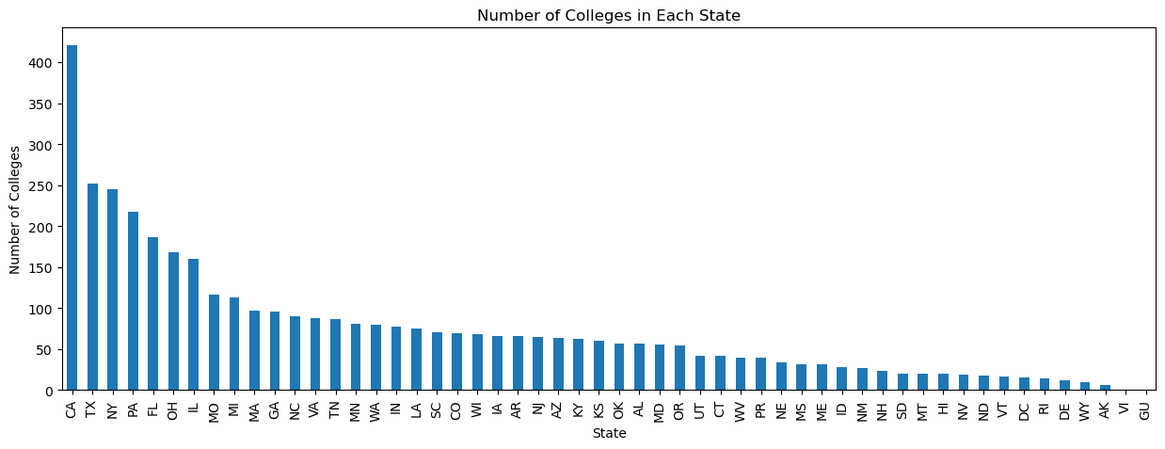
Number of colleges in each state receiving federal loans

Slide 6
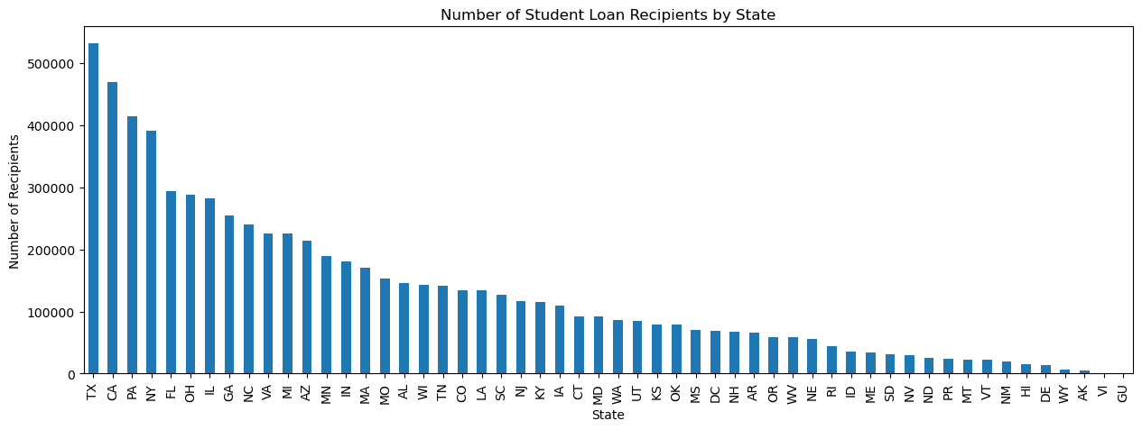
Number of recipients of student loans by State

Slide 7
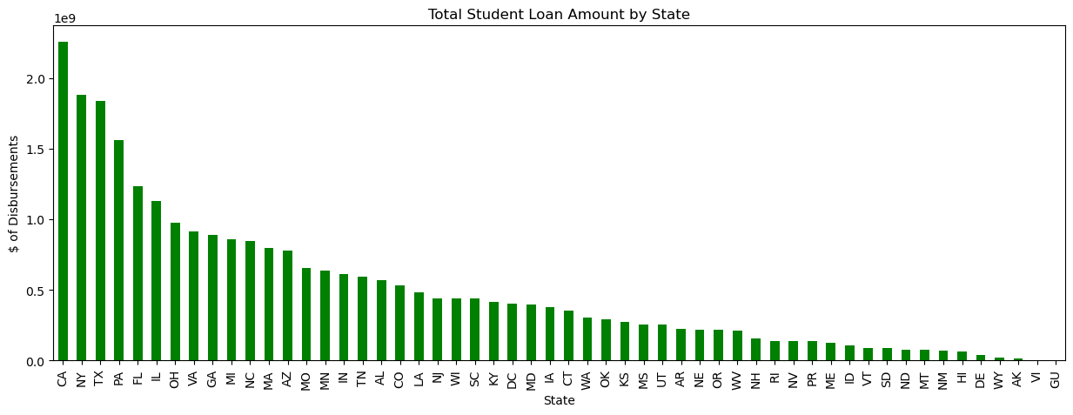
Total amount of student loans by State

Slide 8
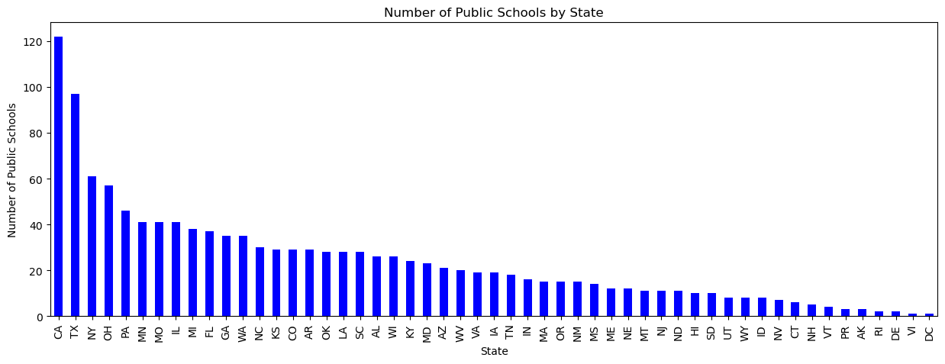
The states with the most public schools receiving Federal student loans

Slide 9
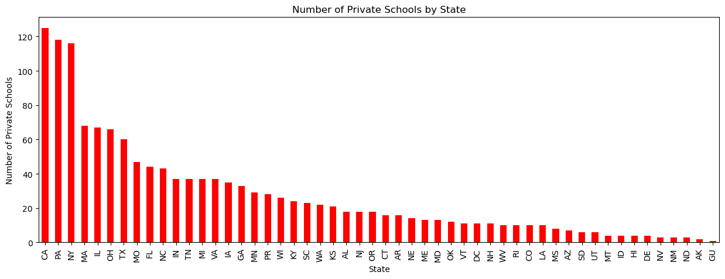
States with the most private schools receiving federal loans

Slide 10
Section 2
The top 10 states with the most student loan amounts in the United States

Slide 11
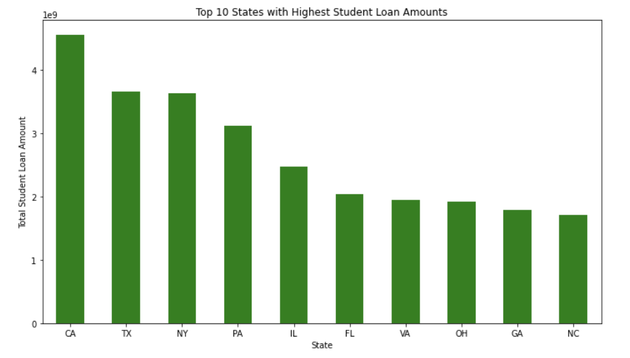
The top 10 states with the most student loan amounts
$ of loans

Slide 12
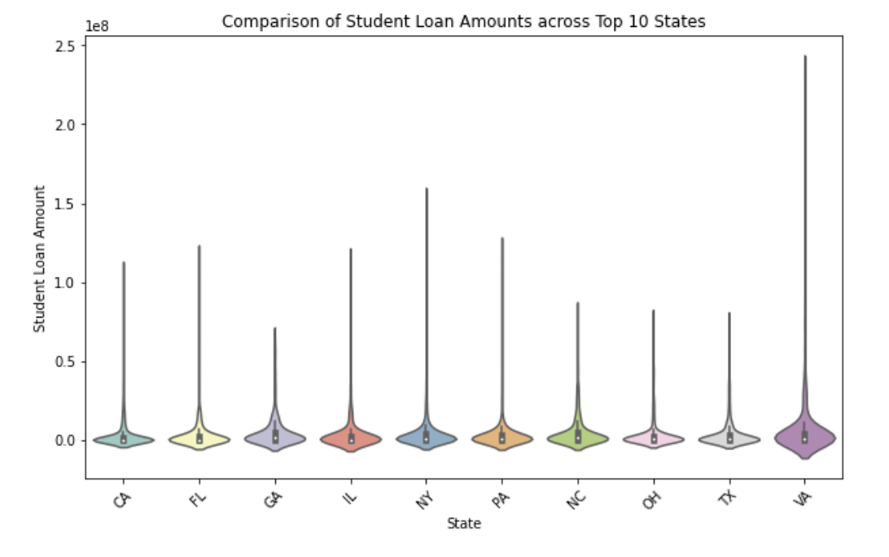
Comparison of student loan amounts across top 10 states
$ of loans

Slide 13
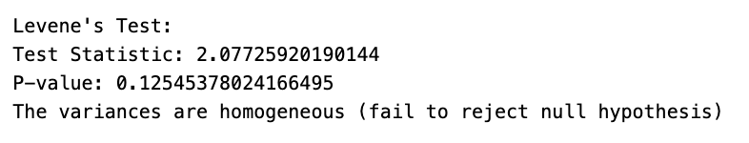
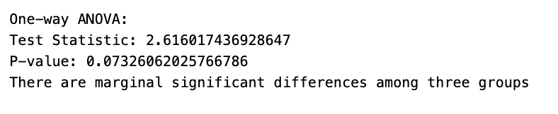
The top 10 states with the most student loan amounts - Differences between first 3 states
$ of loans
Tukey-Kramer Test - Pairwise Comparisons

Slide 14
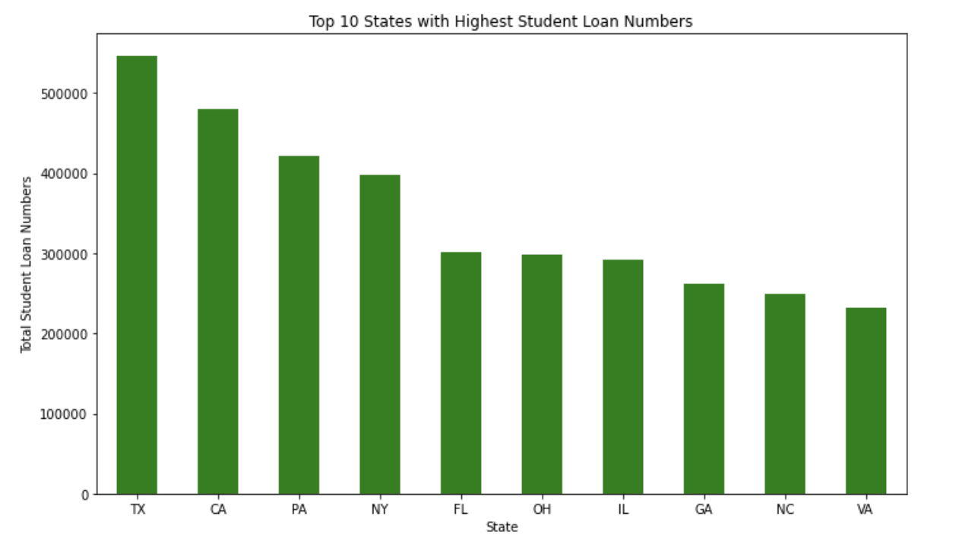
The top 10 states with the most number of student loans
# of loans

Slide 15
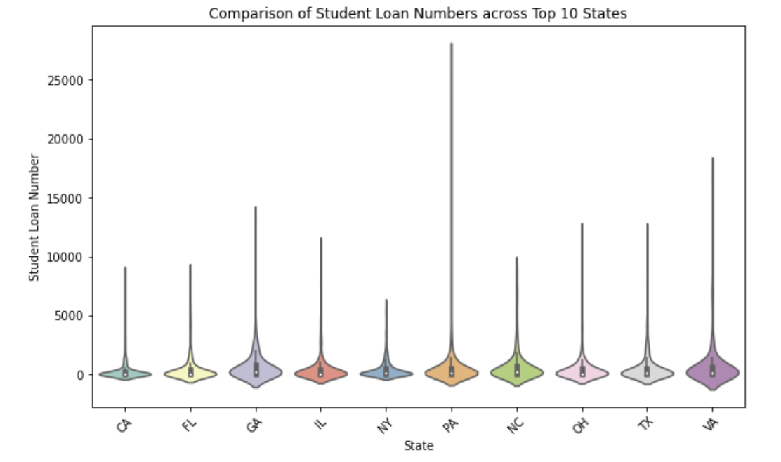
Comparison of the number of student loans across top 10 receiving states
# of loans

Slide 16
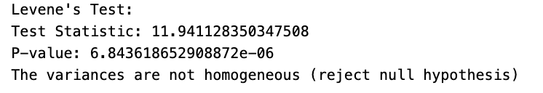
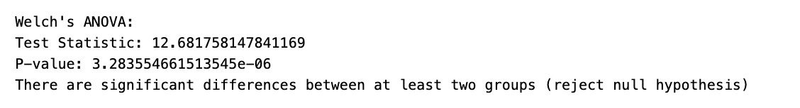
The top 10 states with the most number of student loans - Differences between first 3 states
# of loans
Games Howell's Test - Pairwise Comparisons

Slide 17
Section 3
State, School Type & Loan Type, What is the breakdown of student loan amounts ($) in the United States

Slide 18
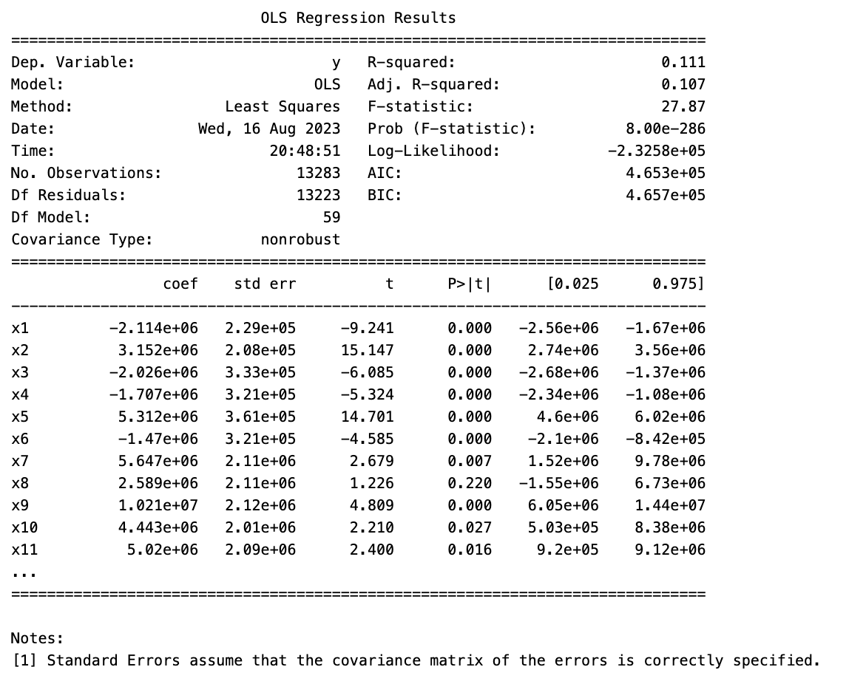

State, School Type & Loan Type, What is the breakdown of student loan amounts ($)?
multivariate linear regression model
ind var: State, School Type & Loan Type
dependent var: $ of loans
Model fitting is bad

Slide 19
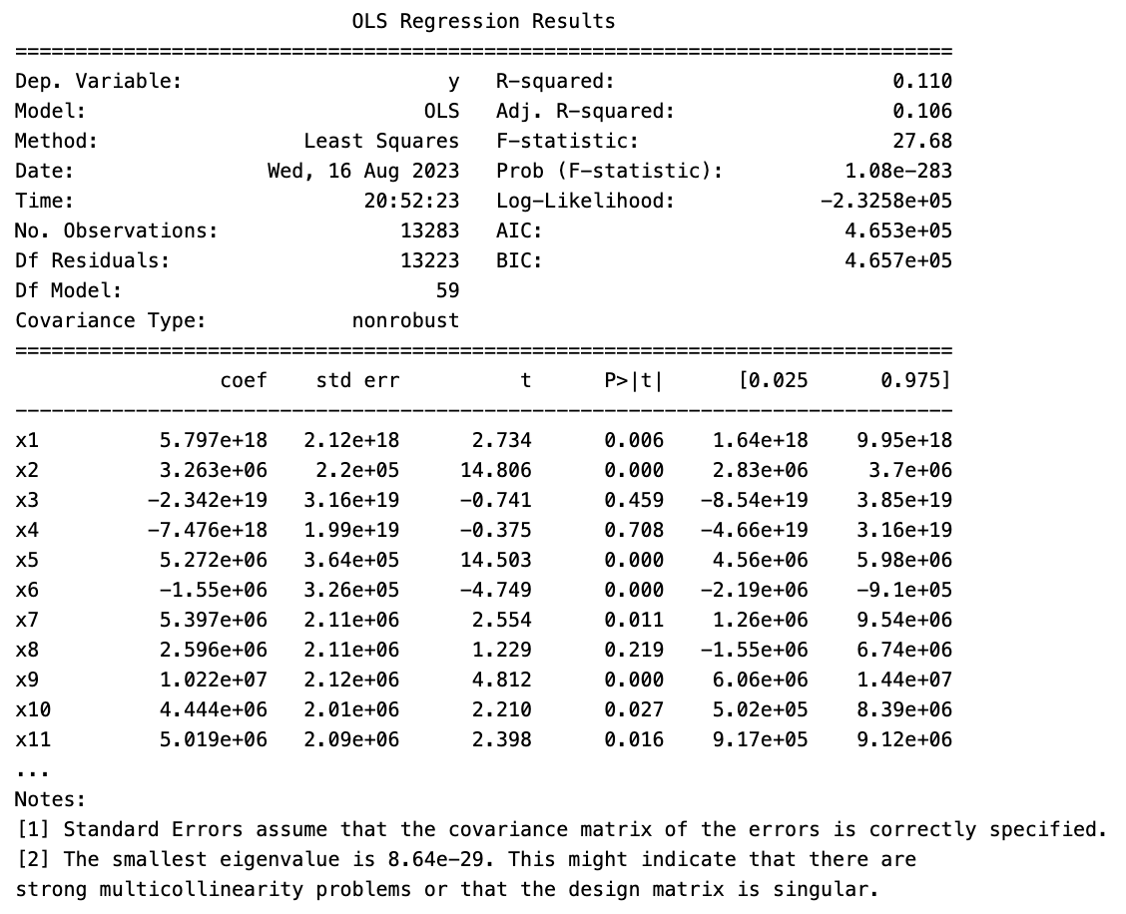

State, School Type & Loan Type, What is the breakdown of student loan amounts ($)?
Multivariate linear regression model
try to add the interaction effect (ex.: School Type_Proprietary* Loan Type_Subsidized) into the model
the model fitting is still bad
Possible reason is the small eigenvalues of the matrix:
the issue of multicollinearity (high correlation among independent variables)
or an issue of Design Matrix Singularity (some variables can be predicted by a linear combination of others)

Slide 20
Section 4
FEDERAL LOAN CATEGORIES
INDIVIDUAL SCHOOLS RECEIVING MOST & LEAST FEDERAL LOANS

Slide 21
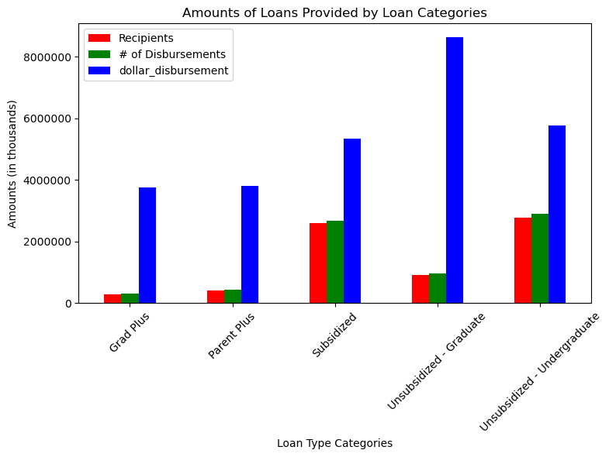
Total loans offered by the 5 types of student loans

Slide 22
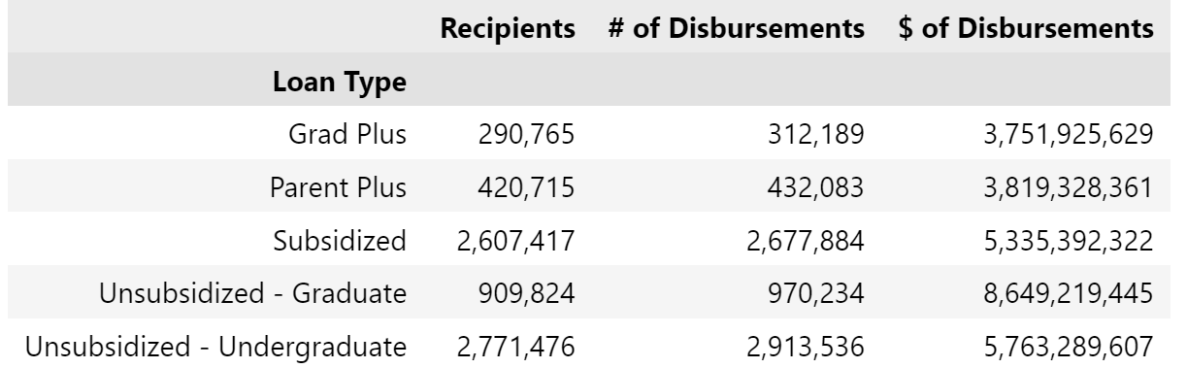
Breakdown by 5 loan types of the number of loans distributed, the total amount of those loans and the number of recipients

Slide 23
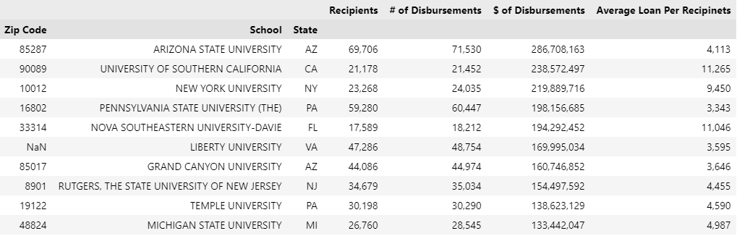
Top ten schools where students received the most loans

Slide 24
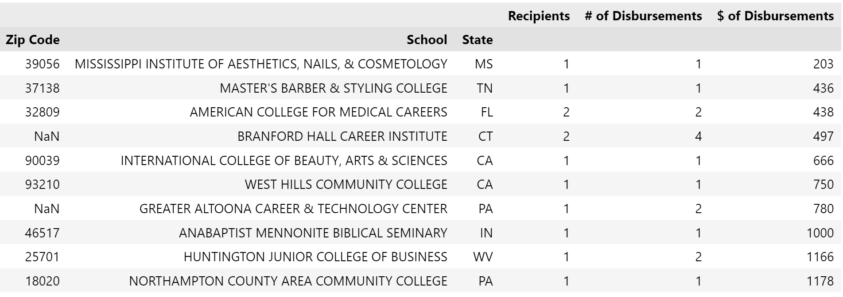
Top ten schools where students received the least loans

Slide 25
Student Loans on a map?

Slide 26
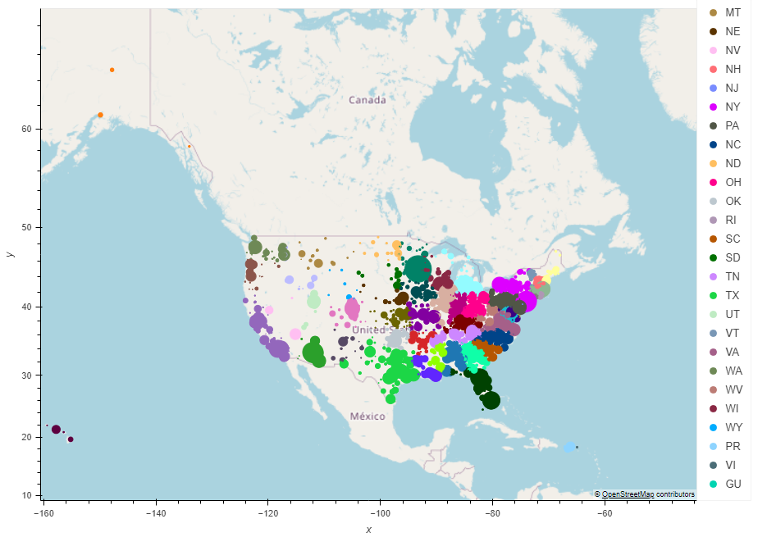
Student Loans on a map

Slide 27
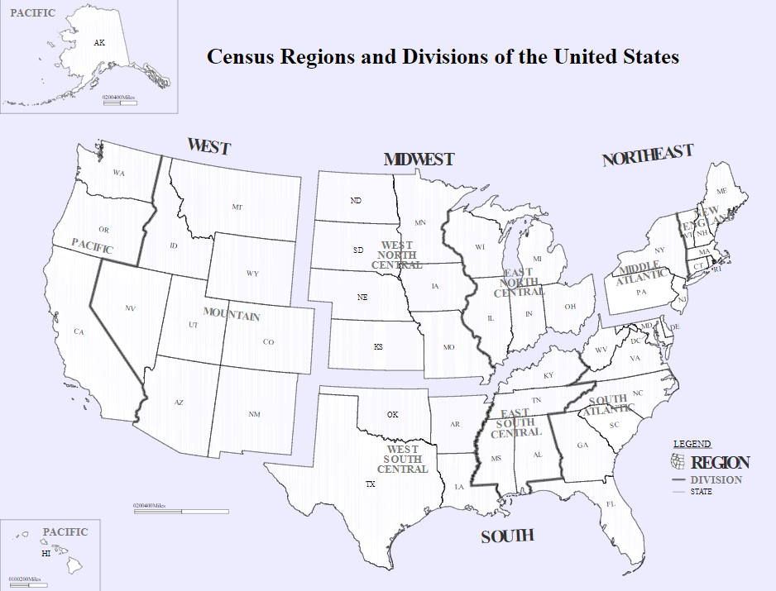
CENSUS REGIONS & DIVISIONS OF THE UNITED STATES

Slide 28
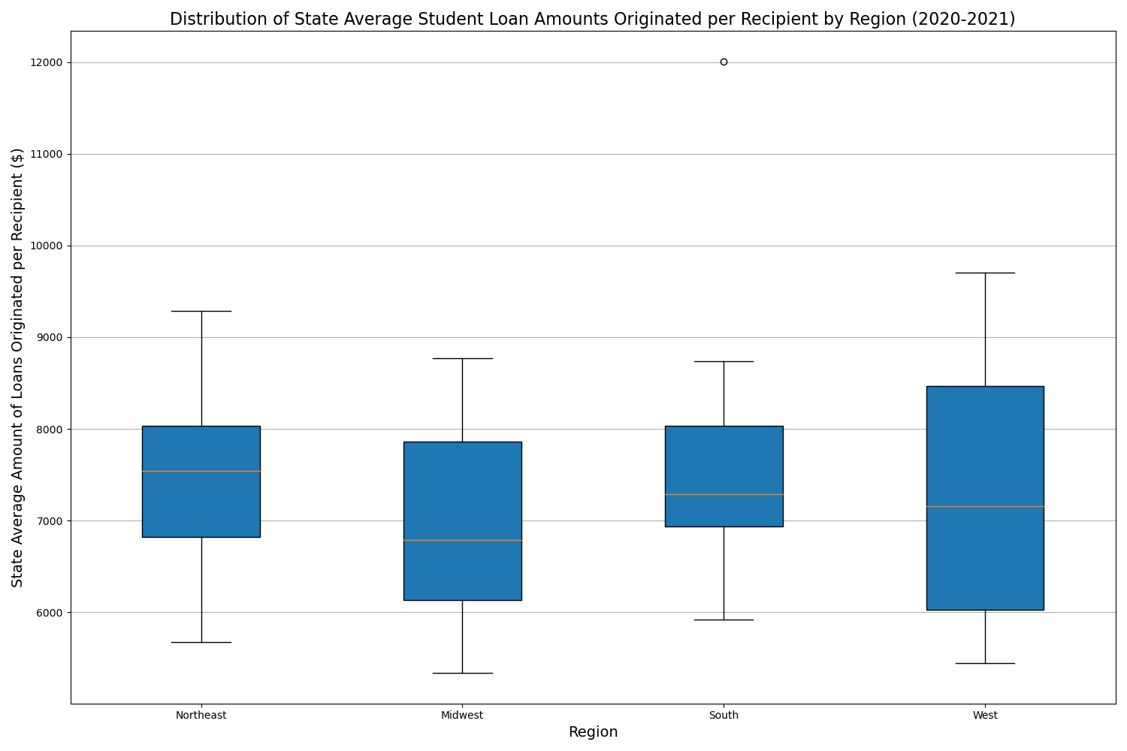
STATE AVG. STUDENT LOAN AMOUNTS PER RECIPIENT BY REGION (2020 - 2021)

Slide 29
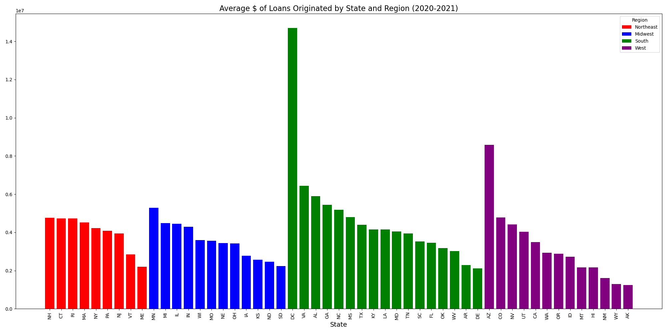
AVG. AMOUNTS OF LOANS ORIGINATED BY STATE AND REGION (2020 - 2021)

Slide 30
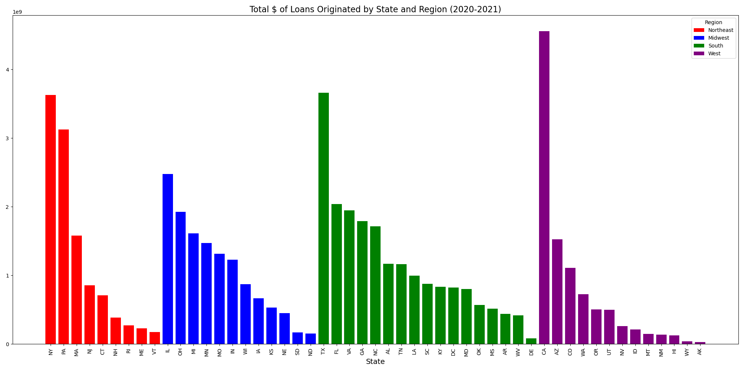
TOTAL AMOUNTS OF LOANS ORIGINATED BY STATE AND REGION (2020 - 2021)

Slide 31
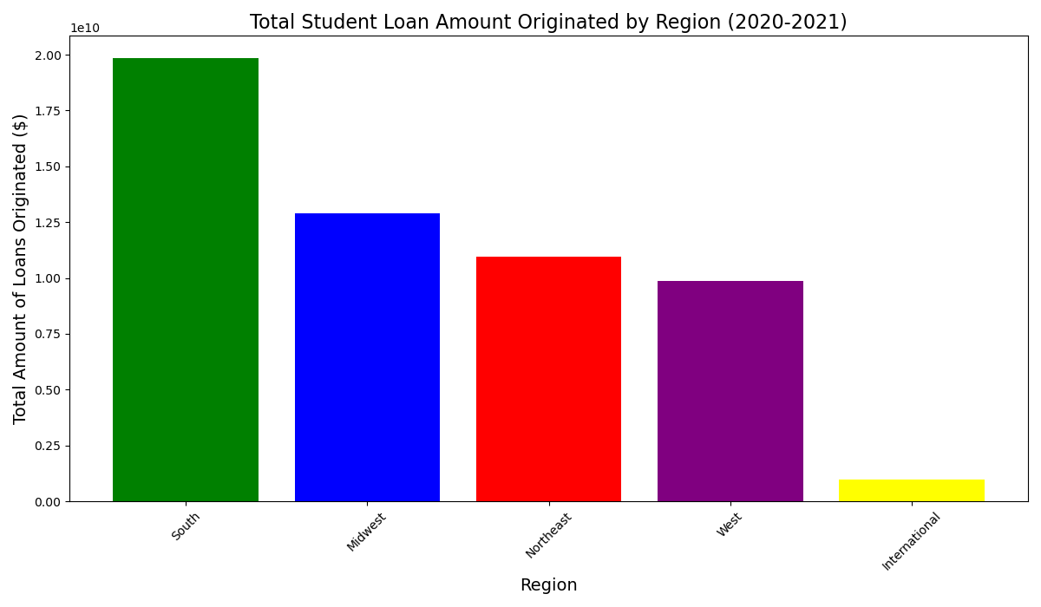
TOTAL STUDENT LOAN AMOUNT BY REGION (2020 - 2021)

Slide 32
Key Limitations
CHALLENGES IN ANALYZING THE DATA
Missing and incorrect zip codes for schools
We only have one year of data so we cannot do any trends analysis in terms of changes in loans over time to schools
A Totals category that continually duplicated loans disbursements and represented almost 50% of the data
Missing information and low quality of data (ex. sample in each group, variance in different groups have huge differences) limited our analysis (ex., correlation and regression), and caused the low validity of the results and bad model fitting.

